Slide 1

JADS MKBdatalab Masterclass Introduction to Time Series Forecasting
Danielle Paes Barretto
Notes:
Photo by Aron Visuals on Unsplash

Slide 2
“ The goal of forecasting is not to predict the future but to tell you what you need to know to take meaningful action in the present. ”
- Paul Saffo

Slide 3
Overview

Slide 4
Time Schema

Slide 5
What is time series analysis ?
Time series analysis deals with data that is ordered in time. Time series data is one of the most common data types and it is used in a wide variety of domains: finance, climate, health, energy, governance, industry, agriculture, business etc. Being able to effectively work with such data is an increasingly important skill for data scientists, especially when the goal is to report trends, forecast, and even detect anomalies.

Slide 6
Examples of Forecasting Applications

Slide 7
Time Series Components
Most time series can be decomposed in:
Trend shows whether the series is consistently decreasing (downward trend), constant (no trend) or increasing (upward trend) over time.
Seasonality describes the periodic signal in your time series.
Noise or residual displays the unexplained variance and volatility of the time series.

Slide 8
Time Series Properties
Time series components help us recognizing some of important properties such as seasonality, cyclicality, stationarity, and whether the time series is additive or multiplicative.
Seasonality x Cyclicality
Image(s) to explain
Notes:
By observing the seasonal component, we can say if the time series is seasonal or cyclic. Seasonality should always present a fixed and known period. If there is no fixed or known period, we are observing a cyclic signal, i.e., cyclicality.

Slide 10
Stationarity
A time series is stationary if its statistical properties do not change over time.
Many algorithms such as SARIMAX models need to deal with stationary time series.
This is important because when running linear regression, for example, the assumption is that all of the observations are independent of each other. However, we know that in a time series observations are time dependent.
So, by making the time series stationary we are able to apply regression techniques to time dependent variables.
In other words, the data becomes easier to analyse over long periods of time as it won’t necessarily keep varying and so, the algorithms can assume that stationary data and make better predictions.

Slide 11
A stationary time series fulfills the following criteria:
The trend is zero.
The variance in the seasonality component is constant: The amplitude of the signal does not change much over time.
Autocorrelation is constant: The relationship of each value of the time series and its neighbors stays the same.
Notes:
In addition, to analyzing the components a common way to check for stationarity is to apply statistical tests such as the Augmented Dicky-Fuller test (ADF) and the Kwiatkowski-Phillips-Schmidt-Shin test (KPSS). Both tests are part of the Python statsmodel library. In the Example's section we give more details about these tests and how to apply them.

Slide 12
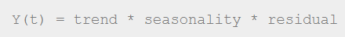
Additive x Multiplicative Model
Additive Model
Multiplicative Model

Slide 13
Example of Time Series

Slide 14
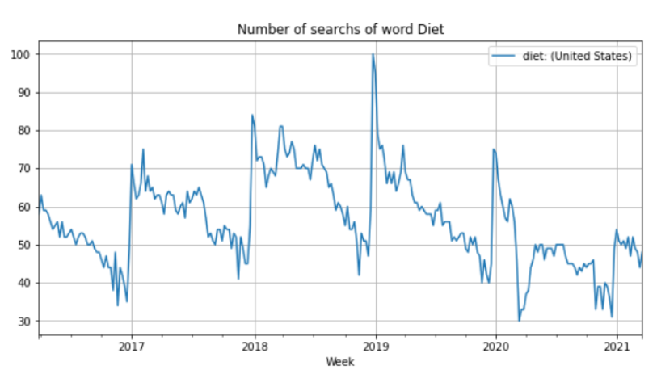
Google Trends Data
Notes:
Consider the search for the word "Diet" from the week starting at 2016-03-27 till week starting at 2021-03-21.
The plot above shows a clear pattern: At the end of the year the word Diet has the lowest number of searches while at the beginning of the year it has the highest number of searches. Do people at the end of the year just want to celebrate and enjoy good food? In consequence, do they choose as New Year’s resolution to become in good shape?
This time series has a seasonal pattern, i.e., it is influenced by seasonal factors. Seasonality occurs over a fixed and known period (e.g., the quarter of the year, the month, or day of the week). In this case the period seems to be yearly and causes a peek at the festivities at the end of year.
We can also observe that there is no constant increase or decrease in trend which would suggest a non-linear trend.
Let's decompose this time series in its components. Because we believe that trend is non-linear, we will set parameter model as multiplicative. By default, this parameter is additive.
Parameter period is optional but you can set it depending on the time series. Because the data is given in weeks, we set the parameter period to the the number of weeks in a year.

Slide 15
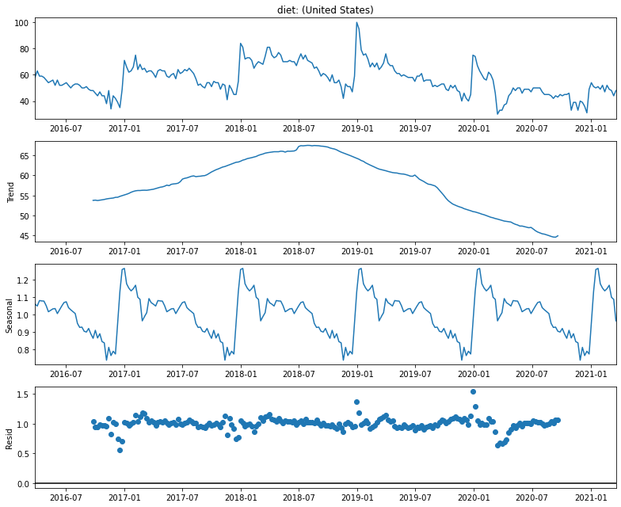
Google Trends Data Decomposition

Slide 16
Stationarity Tests
Augmented Dicky-Fuller test (ADF) is a very popular test for stationarity. However, it can happen that a time series passes the ADF test, without being stationary.
Kwiatkowski-Phillips-Schmidt-Shin (KPSS) is another test for checking the stationarity of a time series.
It is prudent to apply both tests, so that it can be ensured that the series is truly stationary. Next to that, we cannot forget the importance of also observing the time series plot.
Notes:
https://www.statsmodels.org/stable/examples/notebooks/generated/stationarity_detrending_adf_kpss.html

Slide 17
Stationary Tests
Explain in a easy way how to interpret
Apply to google trend

Slide 18
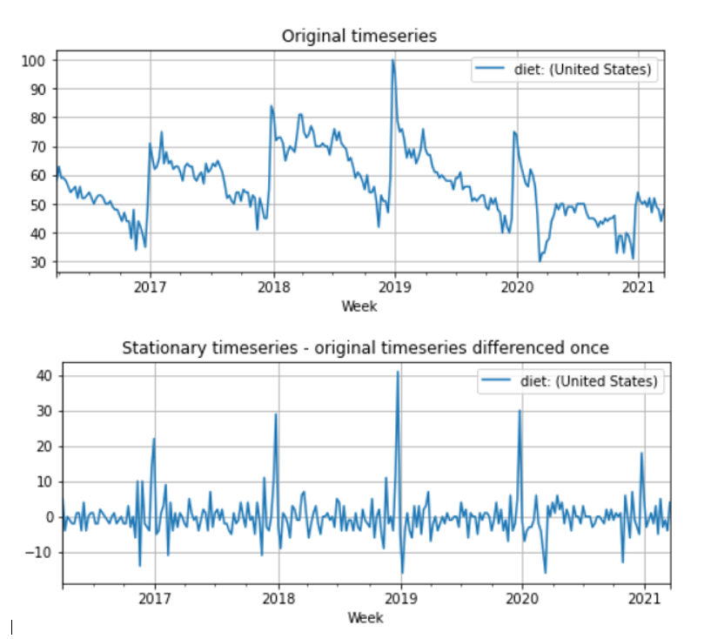
Making Time Series Stationary

Slide 19
Links
Time Series Part 1: An Introduction to Time Series Analysis
Time Series Part 2: Forecasting with SARIMAX models: An Intro
Time Series Part 3: Forecasting with Facebook Prophet: An Intro

Slide 20
Questions? Comments?

Slide 21


Slide 22

Thanks!
mkb

Slide 23
Added in 16/03

Slide 24
What is Forecasting?

Slide 25
Examples

Slide 26
What is a Time Series?
A time series is a sequence of data points with the follow characteristics
It's over a continuous time interval
There are sequential measurements across that interval
There is equal spacing between every two consecutive measurements
Each time unit within the time interval has at most one data point

Slide 27
The Business Problem

Slide 28
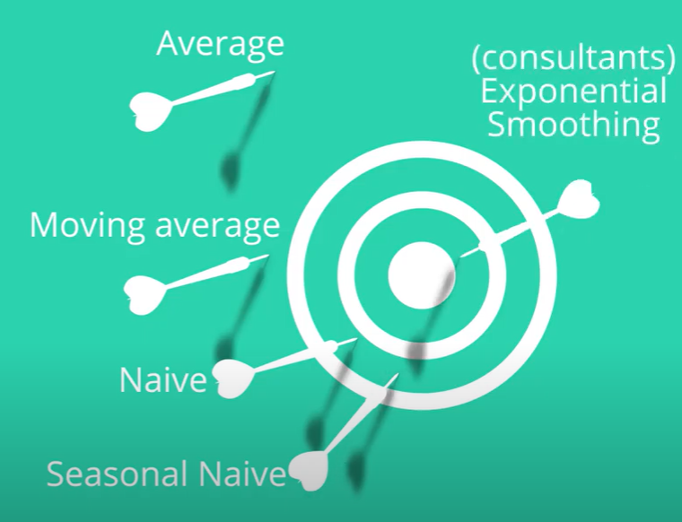
Simple Forecasting Methods
Explain a bit each method
Choose another image

Slide 29
Time Series Components

Slide 30
Trend
Shows whether the series is consistently decreasing (downward trend), constant (no trend) or increasing (upward trend) over time.

Slide 32
Seasonality
Describes the periodic signal in your time series. Seasonality should always present a fixed and known period.
These changes usually happen on a regular basis, like on a daily, weekly, or yearly basis. Seasonality is usually caused by natural cyclical patterns or by the conventions of the people regarding certain dates and times.

Slide 33
Cyclical Patterns
Cycles are patterns of peaks and dips in a time series that are caused by how the value in the series at one time is determined by the values at earlier times. This type of behaviour can be seen in economies, epidemics, animal populations, volcano eruptions, and other natural processes.

Slide 34
Seasonality vs Cyclicality
The difference between cyclic behaviour and seasonality is that cycles don't necessarily depend on the particular date of occurrence - it's more about what has happened in the recent past. This independence from time makes cycles much less regular than seasonal patterns.

Slide 35


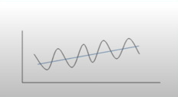
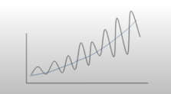
Additive x Multiplicative Model
Y(t) = trend + seasonality + residual
Y(t) = trend + seasonality + residual
Trend and Seasonal variation relatively constant over time.
Trend and Seasonal variation increases or decreases in magnitude over time.
Notes:
Additive
* Linear trend: trend is a straight line
* Linear seasonality: Seasonality with same frequency (width of cycles) and amplitude (height of cycles).
Multiplicative
* Non-linear trend: trend is a curved line
Non-linear seasonality: Seasonality varies in frequency (width of cycles) and/or amplitude (height of cycles).
One of the main objectives for a decomposition is to estimate **seasonal effects** that can be used to create and present seasonally adjusted values (https://online.stat.psu.edu/stat510/lesson/5/5.1). So to choose between additive and multiplicative decompositions we consider that:
* The additive model is useful when the seasonal variation is relatively constant over time.
* The multiplicative model is useful when the seasonal variation increases over time.

Slide 36
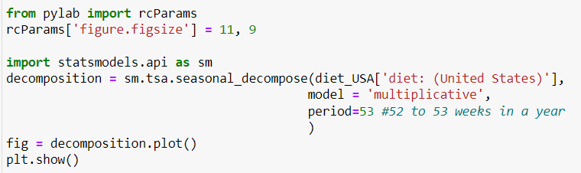
Time Series Decomposition
We will have the help of the Python’s statsmodels library seasonal_decompose to access the components of time series.

Slide 37

on time….
Let’s decompose some time series and analyze:
Trend,
Seasonality vs Cyclicality,
Additive vs Multiplicative behavior
Use library seasonal decompose to decompose time series on datasets:

Slide 38
Stationarity
A stationary time series fulfills the following criteria:
Trend zero
The variance in the seasonality component is constant: The amplitude of the signal does not change much over time.
Autocorrelation is constant: The relationship of each value of the time series and its neighbors stays the same.
Why is it important?
If a time series exhibits a certain behavior over a period of time, then it is likely that it will have the same behavior over a different time period, so long as the time series is stationary. This helps in making forecasts with a higher degree of accuracy. Algorithms such as ARIMA and its variants rely on this property.

Slide 39
Stationarity tests
Augmented Dicky-Fuller test (ADF)
Null Hypothesis: The series has a unit root, meaning it is non-stationary. It has some time dependent structure.
Alternate Hypothesis: The series has no unit root, meaning it is stationary. It does not have time-dependent structure.
A p-value below a threshold (such as 5% or 1%) suggests we reject the null hypothesis (stationary), otherwise a p-value above the threshold suggests we fail to reject the null hypothesis (non-stationary).
Kwiatkowski-Phillips-Schmidt-Shin (KPSS)
Null Hypothesis: The process is trend stationary.
Alternate Hypothesis: The series has a unit root (series is not stationary).
A p-value below a threshold (such as 5% or 1%) suggests we reject the null hypothesis (non-stationary), otherwise a p-value above the threshold suggests we fail to reject the null hypothesis (stationary).
Important: Apply both since it can happen that a time series passes the ADF test, without being stationary.

Slide 40
on time….
Let’s test for stationarity using ADF and KPSS tests.
 | ADF | KPSS | Conclusion
Case 1 | p > threshold (non-stationary) | p < threshold (non-stationary) | TS is not stationary
Case 2 | p < threshold (stationary) | p > threshold (stationary) | The series is stationary
Case 3 | p > threshold (non-stationary) | p > threshold (stationary) | The series is trend stationary
Case 4 | p < threshold (stationary) | p < threshold (non-stationary) | The series is difference stationary

Slide 41
Time Series Scenarios
Time Series has a trend?
If yes, is the trend increasing linearly or exponentially?
Time Series has seasonality?
If yes, do the seasonal components increase in magnitude over time?
No-Trend, No-Seasonal | No-Trend, Seasonal-Constant | No-Trend, Seasonal-Increasing
Trend-Linear, No-Seasonal | Trend-Linear, Seasonal-Constant | Trend-Linear, Seasonal-Increasing
Trend-Exponential, No-Seasonal | Trend-Exponential, Seasonal-Constant | Trend-Exponential, Seasonal-Increasing

Slide 42
ETS models
How to apply
1. Decompose times series
2. Identify if trend, seasonality, and error are additive or multiplicative
Notes:
Trend: If the trend is linear then you apply it additively. If the trend line grows or shrinks exponentially, then you would apply it multiplicatively.
Seaonality: If the peaks and valleys for seasonality are constant over time, you apply it additively. If the seasonality grows or shrinks overtime, then you would apply it multiplicatively. For seasonality, you don't have to consider if the change is linear or exponential, only if it is growing or shrinking over time.
Error: If the error has constant variance over time (peaks and valleys are about the same size), then you apply it additively. If the error is growing or shrinking over time, then you would apply the error multiplicatively.

Slide 43
ARIMA models

Slide 44
Auto Regressive Integrated Moving Average models
There are two types:
Non-seasonal ARIMA, or simply ARIMA
Seasonal ARIMA, or SARIMA

Slide 45
Non-seasonal ARIMA
ARIMA (p, d, q)
AR (p) : AutoRegressive component
I (d) : differencing component
MA (q) : Moving Average component
Number of periods of the TS used in the calculation
Number of transformations used to transform a TS into a stationary one
Number of lags of the error component
Notes:
Purely AR models look like linear regression models where the predictive variables are the p previous periods.
A stationary series is a series without trend or seasonality
Error component: The part of the series not explained by trend or seasonality
MA models look like linear regression models where the predictive variables are the q previous periods of errors

Slide 46
Stationarity
Stationary time series has mean and variance constant over time.
Notes:
Station

Slide 47
Differencing
Differencing is a method of transforming a non-stationary time series to a stationary one.
The number of times of differencing needed to render the series stationary will be the differenced I(d) term in our ARIMA model.

Slide 48
Autocorrelation Function (ACF) Plot (correlogram)
Autocorrelation : How correlated a time series is with its past values.
If the time series is non-stationary we need to use differencing to make it stationary. After making the time series stationary we can use the ACF of the stationary time series to define if we will use AR, MA or both components, as well as how many lags we should use.
If the stationarized series has a positive correlation at Lag-1, AR terms are the best. If it has a negative correlation at Lag-1, then MA terms are best.
The decay or cut off of the ACF will give us hints at what terms to use, as well as spikes decaying towards 0.
Following, we take a look at PACF that will help us confirming our findings.
EXPLAIN WITH AN EXAMPLE – GRAPH BEFORE AND AFTER DIFFERENCING
CHECK ALSO CORRECTION OF THE COMMENT

Slide 49
Partial Autocorrelation Function Plot
Partial correlation: The correlation between two variables controlling for the values of another set of variables.
ACF calculates the correlations of each of the previous points with a value.
PACF calculates the correlations of these points controlling for the values of all previous lag variables.
PACF suggests how many AR or MA terms you need to use to explain the autocorrelation pattern in the time series.
If the PACF drops off at lag number k, it generally indicates an AR(k) model.
If it drops off more gradually, it suggests a MA model

Slide 50
Autoregressive (AR) Component (p)

Slide 51
Moving Average (MA) Component (q)
MA pure components smooths sundle jumps in a time series.
Indicators that points for using MA terms in a ARIMA model are:
MA series are usually negatively correlated at Lag-1
ACF that cuts off sharply after a few lags
PACF that decreases out more gradually

Slide 52
Integrated (I) Component (d)
Number of times we have to difference our dataset to make it stationary.
If the time series must de differenced to be made stationary, we consider it integrated.
Using the information extracted from AFC, PAFC, and the number of times we needed or not do differenced our time series we obtain the parameters p,d, q, i.e. ARIMA(p,d,q)

Slide 53
Seasonal ARIMA Models
Non - Seasonal
Seasonal
ARIMA(p, d, q)
ARIMA(p, d, q)(P,D,Q)m
p: Autoregressive component
d: Differencing component
q: Moving Average component
p, d, q : like in the non-seasonal ARIMA
m: Number of periods in each season (e.g. monthly data m=12)
P: Autoregressive component for the seasonal part
D: Differencing component for the seasonal part
Q: Moving average component for the seasonal part

Slide 54
Seasonal Differencing

Slide 55
Seasonal AR and MA Terms (P, Q)
AR TERMS
MA terms
ACF slowly decays
PACF drops to zero
Most appropriate when seasonal autocorrelation is positive
ACF drops to zero
PACF slowly decays
Most appropriate when seasonal autocorrelation is negative
Notes:
To obtain the seasonal ARIMA terms P and Q we use the patterns appear in ACF and PACF plots that use seasonal lag

Slide 56
Constructing an ARIMA Model
Use the list bellow as basis. Check https://learn.udacity.com/courses/ud980/lessons/dfb36d49-a570-45b8-ba00-9abb6530dd51/concepts/1d569886-f81c-498c-9672-7c62ab598241
Step 1 - Check stationarity: If a time series has a trend or seasonality component, it must be made stationary before we can use ARIMA to forecast. Use the TS Plot tool to see if the time series is stationary.
Step 2 - Difference: If the time series is not stationary, it needs to be stationarized through differencing. Take the first difference, then check for stationarity. Take as many differences as it takes. Make sure you check seasonal differencing as well.
Step 3 - Filter out a validation sample: This will be used to validate how accurate our model is. Use the last 6 periods as the validation sample.
Step 4 - Select AR and MA terms: Use the ACF and PACF to decide whether to include an AR term(s), MA term(s), or both.
Step 5 - Build the model: Build the model and set the number of periods to forecast to 6.
Step 6 - Validate model: Compare the predicted values to the actuals in the validation sample.

Slide 58
Forecasting with Facebook Prophet
How to apply Facebook Prophet for forecasting
How to search for the best model using hyperparameter fine tunning
How to evaluate the obtained model
How to save the chosen model for future use

Slide 59

Facebook Prophet
Open-source forecasting tool available in R and Python.
Open sourced in 2017 Facebook’s core Data Science team. It is full optimized for the business forecasts tasks they encountered at Facebook. It is still used internally.
Prophet is a procedure for forecasting time series data based on an additive model, and the implementation supports trends, seasonality, and holidays.
It works best with time series that have strong seasonal effects and several seasons of historical data.
Prophet is robust to missing data and shifts in the trend, and typically handles outliers well.
Accurate and Fast: Still used internally by Facebook for producing reliable forecasts for planning and goal setting. Fit models in Stan so that you get forecasts in just a few seconds.
Fully automatic: Has the capacity of find automatically a good set of hyperparameters for the model so non-experts users can quickly make high quality forecasts.
Tunable Forecasts: Prophet allows also hand tunning parameters so experts can improve theirs results.
Notes:
Stan is a state-of-the-art platform for statistical modeling and high-performance statistical computation.

Slide 60
Probable datasets
https://www.kaggle.com/datasets/kishorkhengare/cement-sales-demand/code
https://www.kaggle.com/code/kishorkhengare/notebook-cement-sales-and-demand-forecasting
https://www.kaggle.com/datasets/ujjwalchowdhury/walmartcleaned
https://public.tableau.com/app/resources/sample-data

Slide 61
Links
https://facebook.github.io/prophet/
https://github.com/facebook/prophet
Example Prophet using holidays and weather effects: https://nbviewer.org/github/nicolasfauchereau/Auckland_Cycling/blob/master/notebooks/Auckland_cycling_and_weather.ipynb

